Slide 1
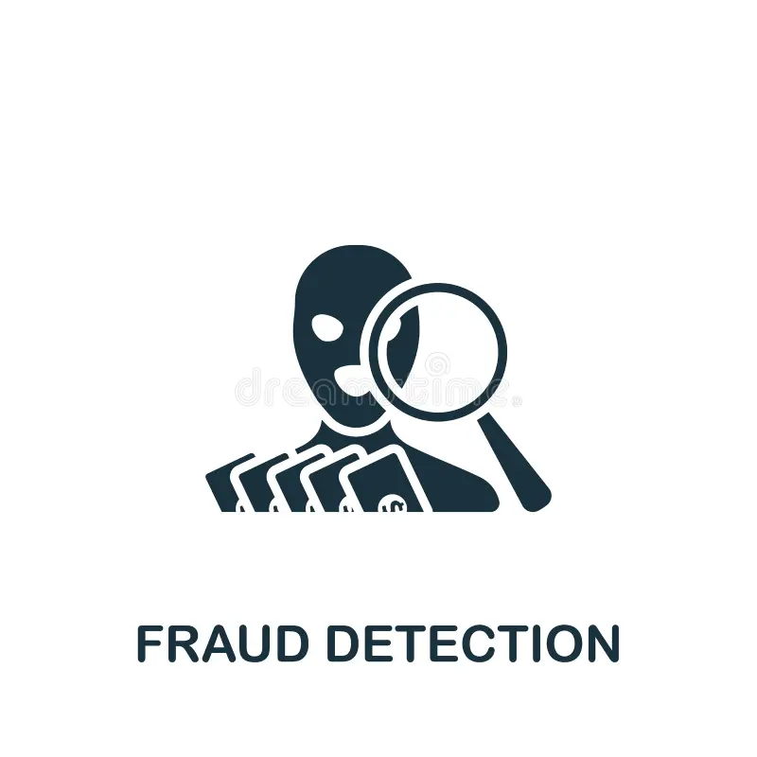
Fraud Analysis Report
Identifying Trends and Patterns to Combat Fraudulent Activities

Slide 2
Purpose of Fraud Analysis
To identify key trends and patterns in fraudulent activities, enabling proactive fraud prevention measures.
To leverage data analytics and machine learning techniques for detecting anomalies and predicting fraudulent behavior with higher accuracy.
To optimize the company's existing fraud detection systems by pinpointing areas of vulnerability and recommending targeted interventions.
To reduce financial losses and enhance security by providing data-driven insights that support strategic decision-making.

Slide 3

Data Analysis on Mobile transactions

Slide 4
What I have worked on in Fraud Data Analysis
I have used Fraud_Analysis_Dataset which was provided to me in this csv format.I took a look at the data to gets knowledge.How many column does it have ,does it have outlier and null values .
After that I looked at the column names and what value it hold
type - CASH-IN, CASH-OUT, DEBIT, PAYMENT and TRANSFER.
amount - amount of the transaction in local currency.
nameOrig - customer who started the transaction
oldbalanceOrg - initial balance before the transaction
newbalanceOrig - new balance after the transaction.
nameDest - customer who is the recipient of the transaction
oldbalanceDest - initial balance recipient before the transaction. Note that there is not information for customers that start with M (Merchants).
newbalanceDest - new balance recipient after the transaction. Note that there is not information for customers that start with M (Merchants).
isFraud - This is the transactions made by the fraudulent agents inside the simulation. In this specific dataset the fraudulent behavior of the agents aims to profit by taking control or customers accounts and try to empty the funds by transferring to another account and then cashing out of the system.

Slide 5
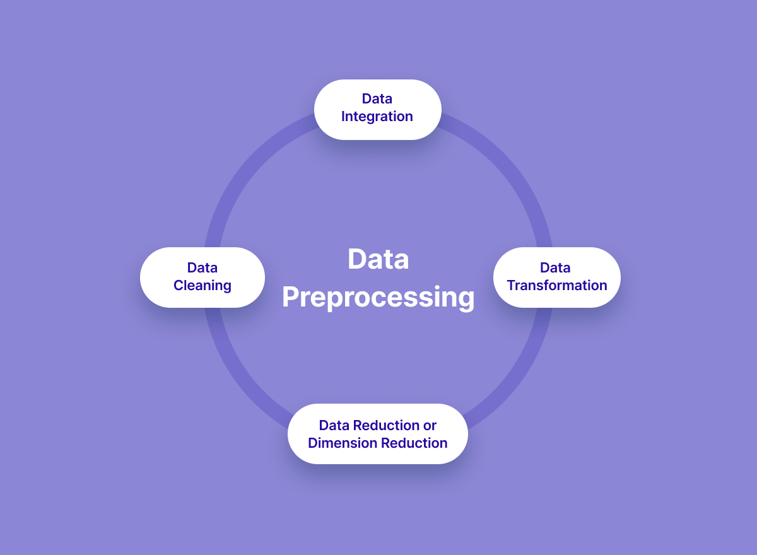
Data Preprocessing
In this process what I did was I checked for the null values in the dataset. In this dataset there we no null values.
After that I used info function(df.info()) in which I wanted to see how big our dataset is which was around 11149 rows and 9 column
After that I did was describe function which is used to tell whether there are outliers in the dataset or not .

Slide 6
Findings of Describe Function
Here we using this function as we want to see min,max,mean,standard deviation of the dataset to see how well it is distributed
Here's a brief interpretation of the statistics:
The average transaction around is 213191.50 and standard deviation is around 760065 which indicates wide range of transactions
The average balance of original accounts is 924117.30 and average of new original balance is 214300.4621

Slide 7

Role of Logistic Regression in Detecting Fraudulent Transactions
Machine Learning in Fraud Detection:
Machine learning is a crucial component of fraud detection, enabling organizations to identify and prevent fraudulent activities with greater accuracy and efficiency. Here are some ways machine learning is used in fraud detection:
Logistic Regression in Fraudulent Transaction Detection Classification Approach:
Logistic regression is used to classify transactions as either fraudulent or legitimate based on input features (e.g., transaction amount, time, location).
Probability Estimation: It predicts the probability that a transaction is fraudulent by modeling the relationship between the features and the likelihood of fraud.
Interpretable Results: The model shows how each feature affects the chance of fraud, helping identify the key factors in detecting it.
Threshold Setting: Based on the predicted probability, a threshold can be set to flag high-risk transactions for further investigation.

Slide 8
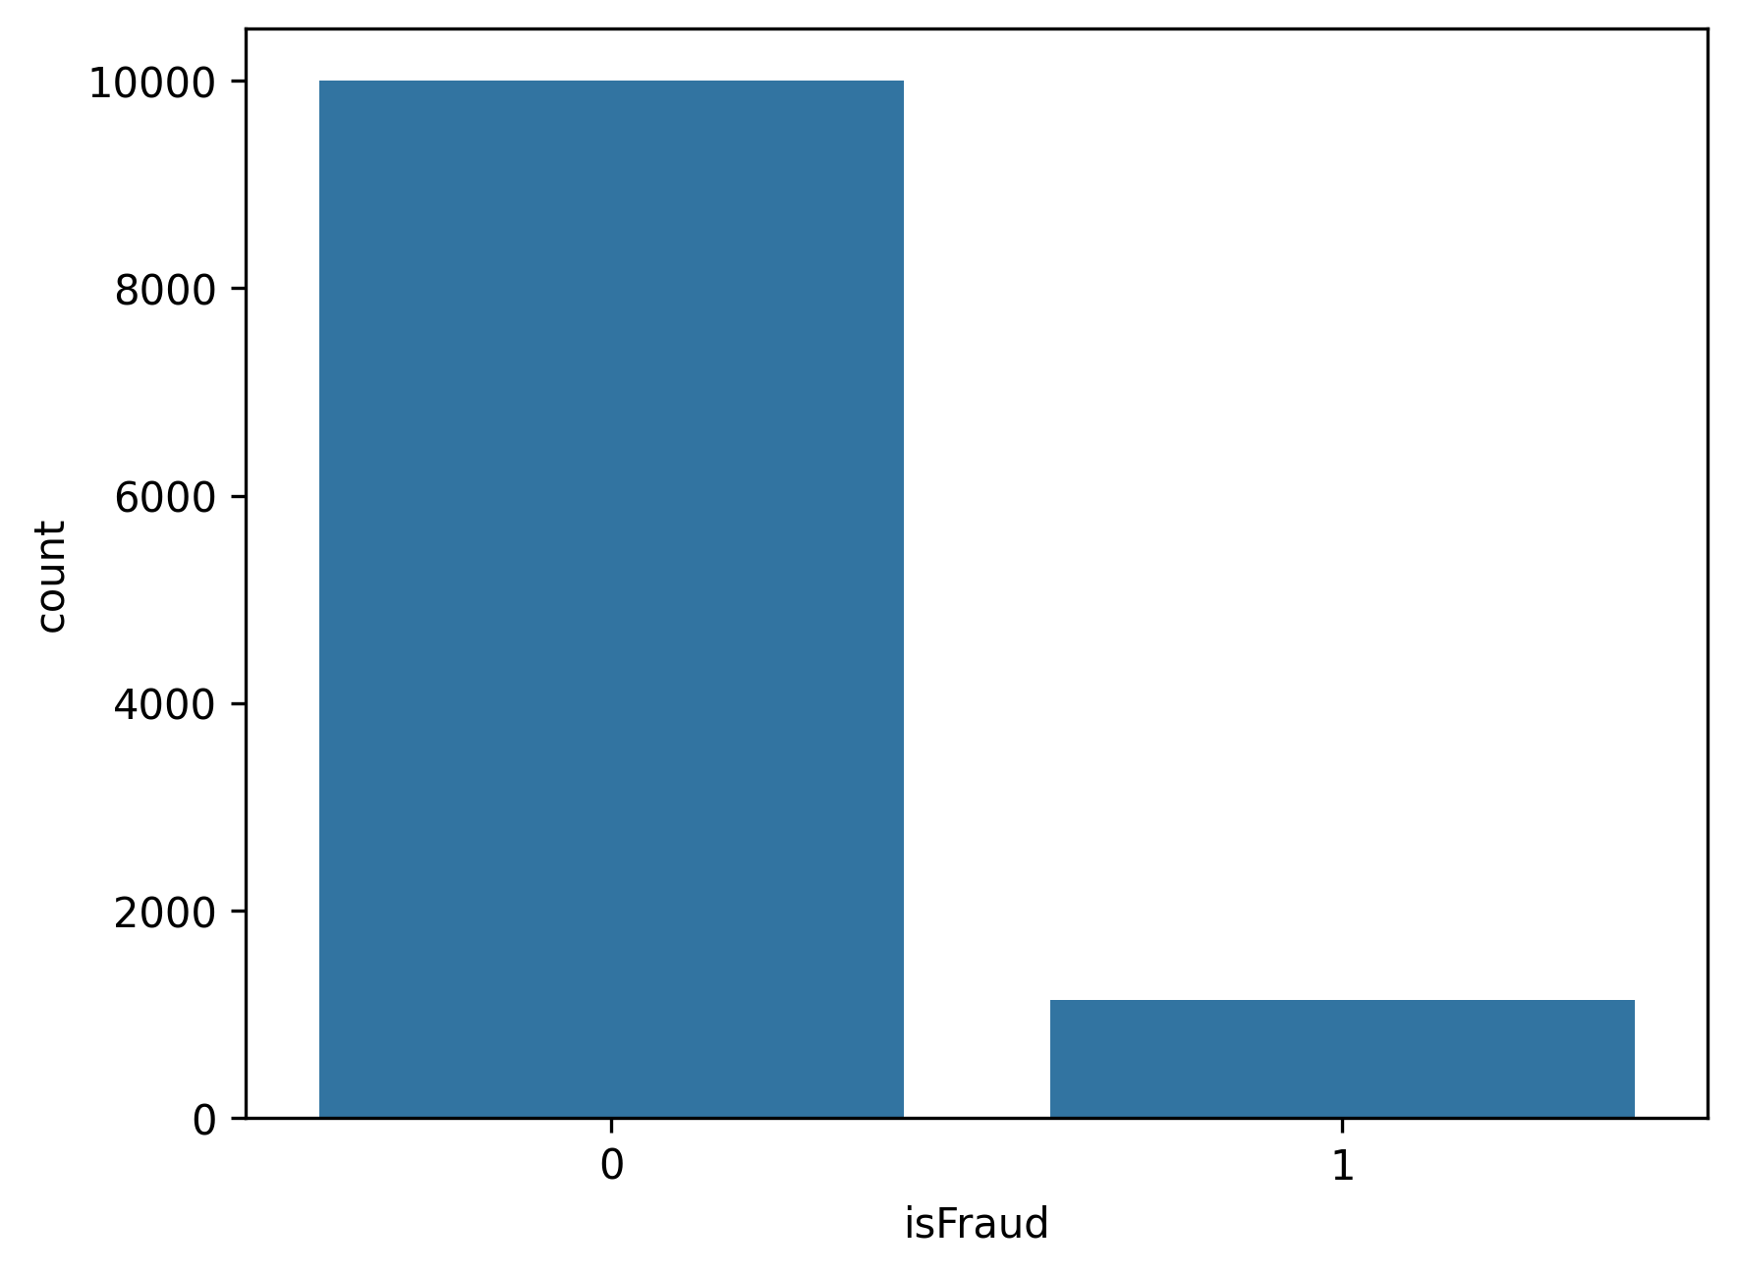
EDA-Exploratory Data analysis
CountPlot
Here I have used countplot to see the volume of transaction fraud or not fraud .
And we can see that 10% of total transactions are fraudant.

Slide 9

ScatterPlot
The graph shows the relationship between the transaction amount and the origin balance. The graph shows that there is a positive correlation between the two variables, meaning that as the transaction amount increases, the origin balance also tends to increase. This makes sense, as larger transactions would typically be made from accounts with higher balance

Slide 10
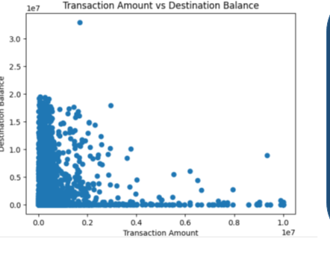
Scatter Plot
The relationship between "Transaction Amount" and "Destination Balance" is less straightforward than the previous graph comparing "Transaction Amount" with "Origin Balance."
Most transactions seem to happen between accounts with relatively small balances, but there are outliers that suggest large balances with small transactions.
This could indicate different transaction behaviors: smaller accounts may be involved in frequent but low-value transactions, while higher-balance accounts may only occasionally receive smaller transactions.

Slide 11
Model Training.
My next step is preparing for a machine learning model by defining feature variables X from specific columns in the df (including amount, oldbalanceOrg, newbalanceOrig, oldbalanceDest, and newbalanceDest) and setting the target variable y as the isFraud column, which indicates fraudulent transactions.

Slide 12
Metrics measurements
0.9264244055630327
Accurarcy Score = .963526244952894
Confusion Matrix = 1987 ,63
12, 167
F1 _score = .8166259168704159
Roc Auc Curve = .9511145932688
Precision score=.9608695
Recall =.5877659

Slide 13
Some more EDA after metrics test
Confusion matrix
From the color intensity, the top-left cell (True Positives) contains a large number of correctly predicted positive instances. In contrast, the other cells have significantly fewer instances.
The matrix suggests that the model is performing well on positive predictions, as indicated by the high number of true positives.
However, the dark purple in the other cells suggests that the model may have few false positives, false negatives, and true negatives, implying an imbalance between the classes or possibly a highly accurate model with minimal errors for the other categories.

Slide 14
Bar Chart

Slide 15
Findings
Findings
The image shows a bar graph representing the expected revenue, losses, and profit of a project. The expected revenue is the highest, followed by the expected profit. This suggests that the project may be using machine learning models to generate predictions about revenue, losses, and profit. Overall, the image suggests that the project is on track to be successful, with high expected revenue and low expected losses.

Slide 16
Conclusion
"With a 96.6% accuracy, we have built a highly reliable system that can significantly reduce fraud losses."
"This accuracy translates into significant real-world benefits. Good on reducing financial losses and enhancing security for customers."
"The model's performance not only protects our business but also ensures a positive user experience for our customers."
"To summarize, we have developed a robust fraud detection model with exceptional accuracy, demonstrating the power of machine learning in combating fraud."

Slide 17
Thank You

